Slide 1

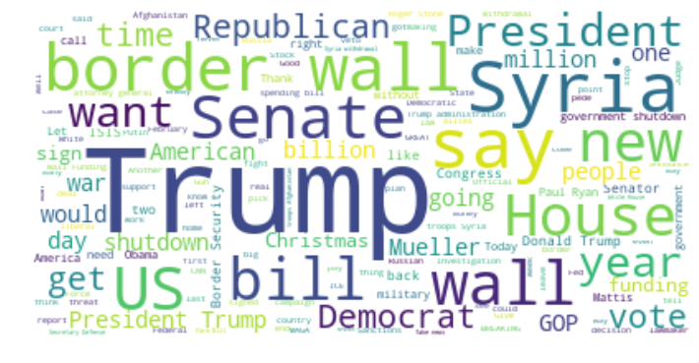
Project #3: Sub-Reddit NLP Classification

Slide 2


Icebreaker
Match Them Up: r/Politics or r/The_Donald ?
vs.

Slide 3


Icebreaker
What about this?
vs.

Slide 4
The Problem
How accurately can we classify a given post into the right sub-Reddit?
The Issue in Context
Moral of Exercise: manual classification is not always quick and easy!
Applications: managing the aftermath of human error / bugs that misclassify posts
The Approach
Collection: Webscrape sub-Reddits with Reddit API (500 posts each)
Cleaning: Filter out irrelevant posts; deal with strange characters.
Word Vectorizers: Count Vectorizer (EDA), TF-IDF Vectorizer (Preprocessing)
Classification Models: (1) Random Forest
(2) Logistic Regression
(3) Support Vector Machine
The Evaluation
Train/Test Split: Train model on 70% of all posts; testing on remaining 30%
Key Metric: Accuracy to determine the best of the three
…vs. Baseline Accuracy (~50%)

Slide 5
Methodology: Exploratory Data Analysis
High-Level Statistics on Subreddits
 | /r/The_Donald | /r/Politics
No. Subscribers | 690,286 | 4,380,649
Mean Comments/Post (% of Subscribers) | 38 (0.0055%) | 187 (0.0042%)
Mean Score/Post (% of Subscribers) | 801 (0.12%) | 2,284 (0.05%)
Metrics
No. of Comments and Scores (= upvotes – downvotes) are the few relevant numeric features from webscraped data ⟹ indicative of subreddit activity
Key Insights
Politics far more popular than The_Donald in absolute terms
However, once adjusted for size, activity is similar…The_Donald slightly more active!
∴ comparable candidates to test our model on
Notes:
*REMOVED FROM FRIDAY 12/21 PRESENTATION TO SAVE TIME*
Before diving into the actual post content, let’s take a look at some high-level statistics. A few numeric features of interest are the number of comments on a post, the score on a post, and the number of reports filed against a post.
Number of reports filed tells us whether a post is worth looking at (not shown here because in this sample it’s 0).
Scores are just the number of upvotes – the number of downvotes, which like number of comments is indicative of how much activity is going on in the subreddit.
Now in terms of sheer quantity, Politics has far more subscribers which explains why it has a higher average number of comments and score per post. But to determine if these posts are actually comparable, we decided to normalize those numbers by representing the means as a % of total subscribers.
After doing that, we see that the means in parentheses are of the same order of magnitude between the two subreddits. So this is worth training and testing our model on.

Slide 6
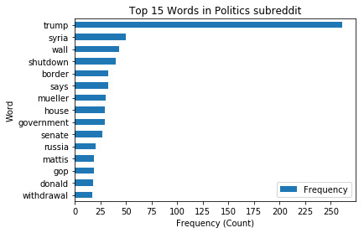
Methodology: Exploratory Data Analysis
Examining the Distribution of Top 15 Words in /r/Politics
Word | Frequency in Sample
trump | 261
syria | 50
wall | 43
shutdown | 40
says | 33
border | 33
mueller | 30
government | 29
house | 29
senate | 27
russia | 20
gop | 19
mattis | 19
donald | 18
withdrawal | 17

Slide 7
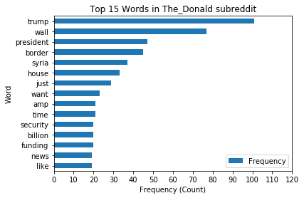
Methodology: Exploratory Data Analysis
Examining the Distribution of Top 15 Words in /r/The_Donald
Word | Frequency in Sample
trump | 101
wall | 77
president | 47
border | 45
syria | 37
house | 33
just | 29
want | 23
time | 21
amp | 21
funding | 20
billion | 20
security | 20
like | 19
news | 19

Slide 8
Methodology: Data Cleaning
Troll Filter: Using “Spam Signals” to filter out irrelevant posts
Troll Filter
Based on numeric features:
num_reports > 0: remove any posts flagged/reported at least once
score < 0: remove any posts with a net negative score
keep 0 scorers - the post may be new!
Eliminating Residual Unicode Text from Data
Noticed “&amp;” from The_Donald EDA
Vectorizers get rid of “&” and “;” but “amp remains!
Replace all instances of “&amp;” with “&” before vectorizing!
Concatenating Title and Sub-Reddit Data into Data Frame
NLP occurs on combined body of text from all subreddits so merge
Binarize Target Variable (Sub-Reddit) s.t. The_Donald = 1, Politics = 0

Slide 9
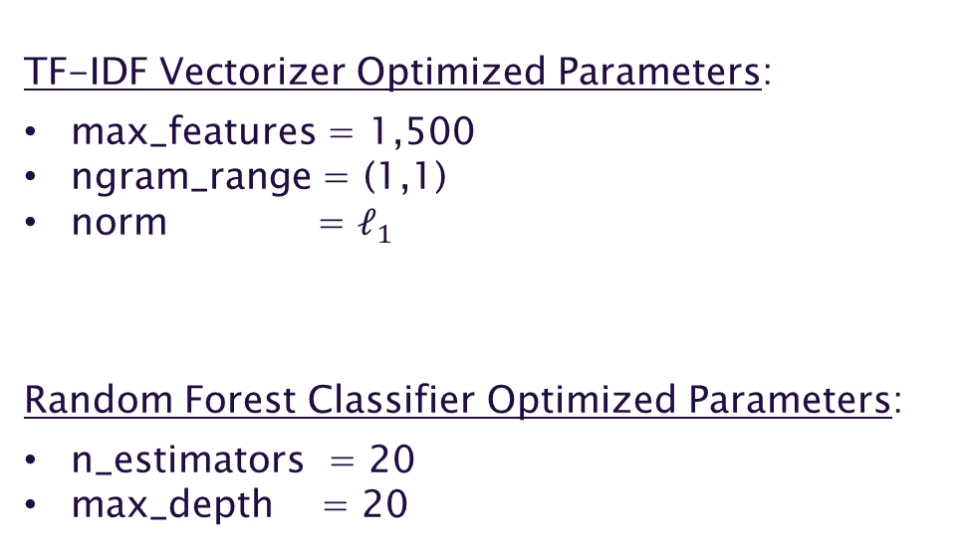
Methodology: Modeling
Model 1: Random Forest
TF-IDF Vectorizer Optimized Parameters:
max_features = 1,500
ngram_range = (1,1)
norm = $ℓ_{1}$
Random Forest Classifier Optimized Parameters:
n_estimators = 20
max_depth = 20

Slide 10
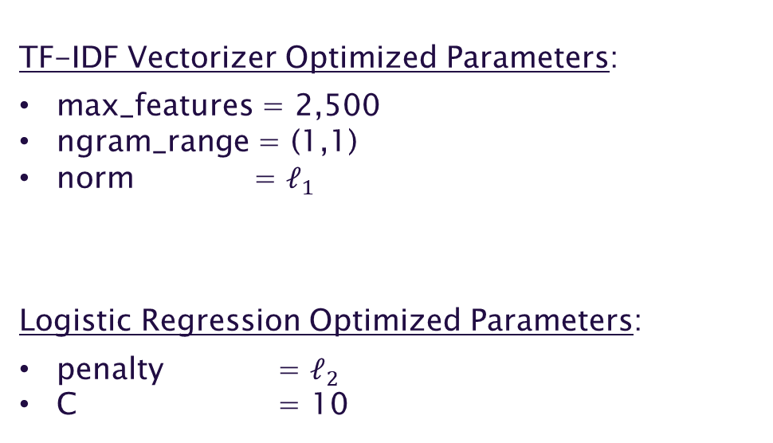
Methodology: Modeling
Model 2: Logistic Regression
TF-IDF Vectorizer Optimized Parameters:
max_features = 2,500
ngram_range = (1,1)
norm = $ℓ_{1}$
Logistic Regression Optimized Parameters:
penalty = $ℓ_{2}$
C = 10

Slide 11
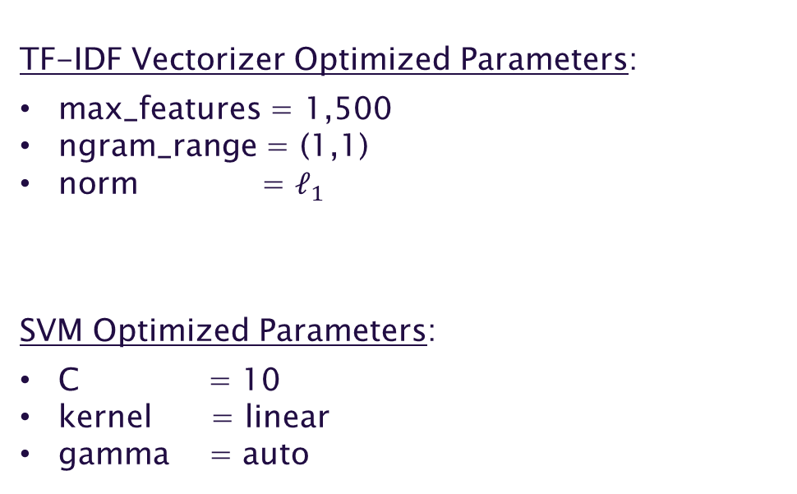
Methodology: Modeling
Model 3: Support Vector Machine (SVM)
TF-IDF Vectorizer Optimized Parameters:
max_features = 1,500
ngram_range = (1,1)
norm = $ℓ_{1}$
SVM Optimized Parameters:
C = 10
kernel = linear
gamma = auto

Slide 12
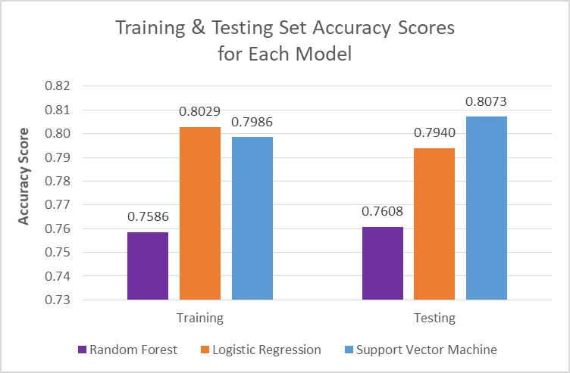
Modeling: Results & Evaluation
Train Accuracy vs. Test Accuracy
 | Model 1: Random Forest | Model 2: Logistic Regression | Model 3: SVM
Training Accuracy | 0.7586 | 0.8029 | 0.7986
Testing Accuracy | 0.7608 | 0.7940 | 0.8073
Overfit? | no | slightly | no
Key Insights
SVM does best in Testing set
Logistic Regression does best in Training set, though results in very slight overfit
Otherwise, virtually no overfit in models

Slide 13
Modeling: Evaluation (Supplement)
Confusion Matrix
Random Forest | Predict Politics (y = 0) | Predict The_Donald (y = 1)
Actual Politics (y = 0) | 100 | 51
Actual The_Donald (y = 1) | 21 | 129
Logistic Regression | Predict Politics (y = 0) | Predict The_Donald (y = 1)
Actual Politics (y = 0) | 122 | 29
Actual The_Donald (y = 1) | 33 | 117
Support Vector Machine | Predict Politics (y = 0) | Predict The_Donald (y = 1)
Actual Politics (y = 0) | 125 | 26
Actual The_Donald (y = 1) | 34 | 116

Slide 14
Modeling: Evaluation (Supplement)
Classification Evaluation Metrics
 | Model 1: Random Forest | Model 2: Logistic Regression | Model 3: Support Vector Machine
Accuracy | 0.7608 | 0.7940 | 0.8007
Sensitivity | 0.8600 | 0.7800 | 0.7733
Specificity | 0.6623 | 0.8079 | 0.8278
Precision | 0.7167 | 0.8014 | 0.8169
Key Insights
Overall: all three models performed well (Accuracy > 0.75)
Support Vector Machine (SVM) outperformed all other models in terms of Accuracy, Specificity (True Negative Rate), and Precision
Random Forest was the worst performer in all areas, except Sensitivity.

Slide 15
Wrapping-Up
Key Takeaways
All beat baseline accuracy (50%)
All accuracy > 75% ⟹ good ability to accurately classify posts
Clear winner: Support Vector Machine model (4 in 5 correct)
Implication: Reddit administrators need to review 1 in 5 misclassified posts
Tuning improvement possible, but SVM very computationally intensive
Further Enquiry
Group synonyms together as features instead of individual words
Take into consideration words that are all caps (indicate shouting/anger), but still apply .lower to words where first letter is capitalized

